Slide 1


Seminar Group 7 Team 6
Heart Detect
A two-stage, analytics-based approach to heart disease prevention
Bryan Lim Kai Wei (U2121763H)
Gerald Ong Jon Kai (U2122864K)
Hong Zhi Hao (U2121820G)
Jiang Lei (U2121557B)
Toh Jing Qiang (U2121442H)
Zainab Zuvairiyah D/O V M Saifudeen (U2010049J)
Notes:
Good evening, ladies and gentlemen.
We are from Team 6, and today we will be presenting on our solution: HeartDetect – a 2 stage preventive approach for heart diseases.

Slide 2

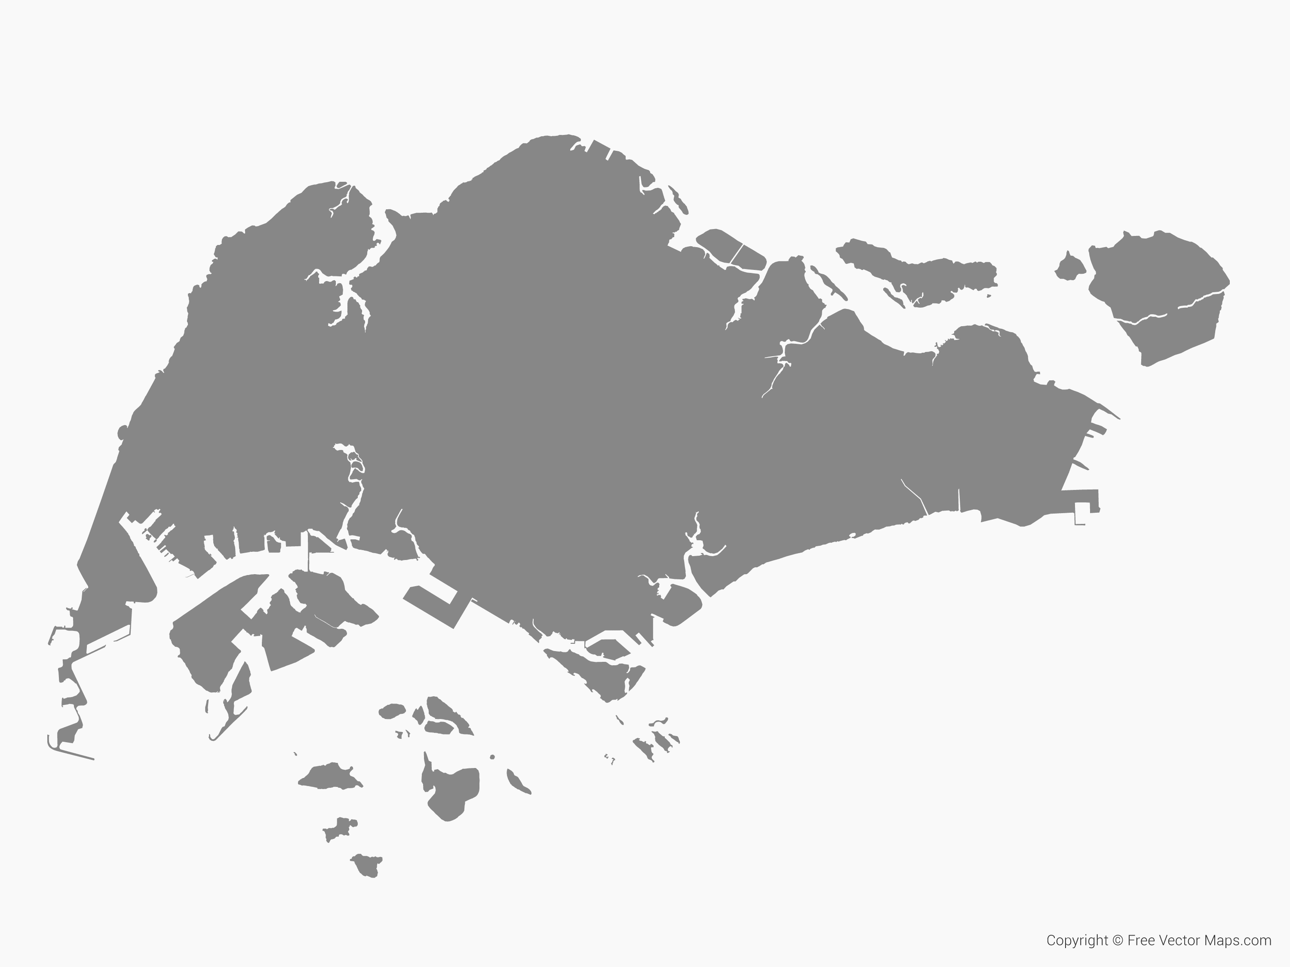





Introduction to Cardiovascular Diseases (CVD) in Singapore
Zhi Hao
Top 3 causes of hospitalization and death
More than 1/3 Singaporeans are not aware of risks factors
1 in 5 Singaporeans have 1 or more risk factors
NCHS handling more than 120,000 outpatients
Manual assessment of CVD risk levels wastes manpower
1 in 3 Singaporeans die due to CVD
Notes:
Background of cvd in Singapore -> Report 1.2

Slide 3
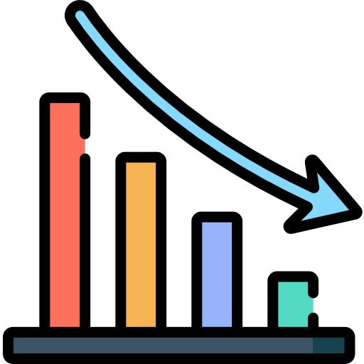



Early Intervention of CVD
Zhi Hao
Reduce deaths
Prevention rather than treatment
Business Problem
80% of CVD can be prevented with the elimination of health risk behaviours
(Piepoli, et al., 2016)
Slow onset of CVD and long incubation periods = large window of opportunity for intervention
Symptoms are generally more serious upon diagnosis
(Qian, et al., 2022)
Early intervention is critical in preventing the onset of CVDs and hence increase the life expectancy of Singaporeans
Creating a prediction tool using data analytics models:
To aid in the early detection and intervention of CVDs
To be utilized by medical professionals at the primary care level (GPs, polyclinics)
Sources: Piepoli, et al. (2016), Qian, et al. (2022)
Notes:
Business problem -> draw main points
Report 1.1 (highlight nhcs statistics [do some more research will be better])

Slide 4



Proposed Solution: HeartDetect
Zhi Hao
Latest solution
Our proposed solution
Predictive Risk Score for CAD In Southeast Asians with Chest Pain (PRECISE)
HeartDetect – a 2 step preventive approach employing data analytical models
Singapore’s 1st CAD risk calculator
Estimates likelihood of patient with no known history using variables such as age, gender, smoking status, ECG changes etc.
Particularly helpful for patients with chest pain to monitor their health status
Limitations
Only targets people presenting with chest pain
Only addresses CAD (Cardiovascular Artery Disease)
Stage 1:
Individual Empowerment
Stage 2:
Primary Medical Care
Individuals can monitor their heart health by answering questions about their biological, medical, behavioral, genetic and environmental information.
Individuals in high-risk category can visit a primary care physician (GP, polyclinic) for screening, where a data analytics model is used a support tool for physicians during decision making
Extend coverage of preventive measures for heart disease
Raise awareness of risk factors
Maximize medical resource allocation
Notes:
Our solution [2 stage]
Aims
Report 1.4

Slide 5





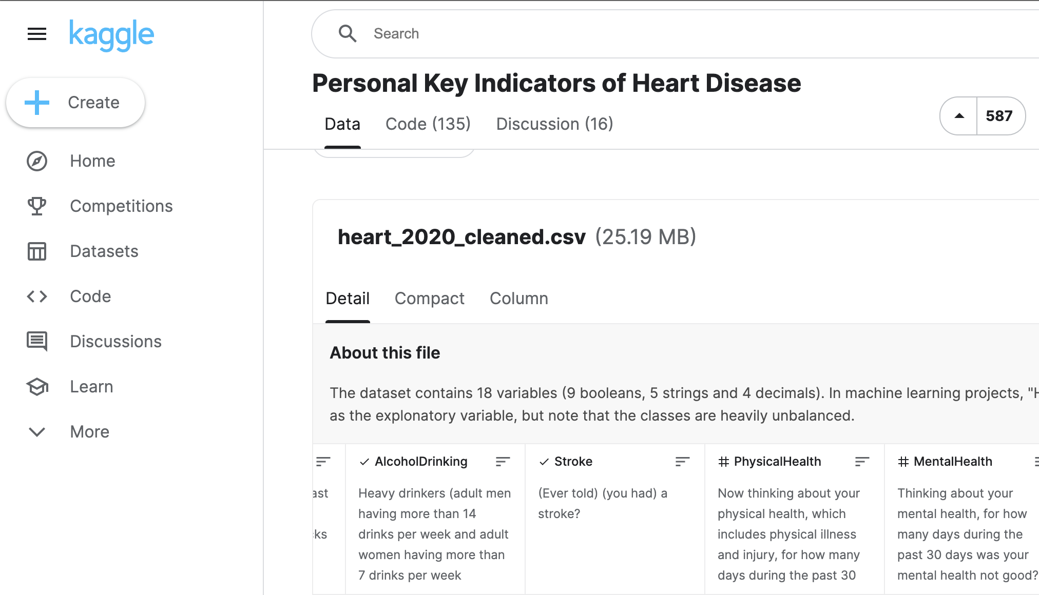

Stage 1: Individual Empowerment – Overview
Jiang Lei
1
2
3
4
5
Data Collection
From Kaggle
[315252 rows & 18 columns]
Data Preprocessing
Data Cleaning
One-hot Encoding
Data Exploration
Feature Engineering
Recursive Feature Elimination
Model Training
Optimize each model
&
Select best model
with predefined metrics
Model Explainer
Understand black-box algorithm
Interpret Prediction
Notes:
Stage 1: Individual empowerment [listing data, overview of dataset]
The first stage of our proposed solution is to allow individuals to easily assess the risk of heart disease using their medical history, lifestyle, recent health condition, etc. If individuals find they are in a high-risk group using the prediction model, they can monitor their health more closely and seek timely medical treatment.
Demographic Variable: age, gender, race, BMI
Medical History: Stroke, Diabetic, Asthma, KidneyDisease, SkinCancer
Lifestyle: Smoking, AlcoholDrinking, PhysicalActivity, SleepTime
Recent Health condition: DiffWalking, GenHealth, PhysicalHealth, MentalHealth

Slide 6







Stage 1: Individual Empowerment – Data Overview
Jiang Lei
Singapore Residents
Personal Information
Monitor Heart Health
Demographical Variables
Medical History
Lifestyle
Recent Health Condition
Age
Gender
Race
BMI
Stroke
Diabetic
Asthma
Kidney Disease
Skin Cancer
* (Ever told) (you had) a disease above?
Smoking
have you smoked at least 100 cigarettes in your entire life?
Alcohol Drinking
adult men > 14 drinks / week adult women > 7 drinks / week
Physical Activity
whether exercise during the past 30 days other than regular job
Sleep Time
how many hours of sleep get in a 24-hour period on average
Difficulty in Walking
General Health
Rate it with Very Good / Good / Excellent / Fair / Poor
Physical Health
how many days during the past 30 was physical health not good?
Mental Health
how many days during the past 30 was mental health not good?
Notes:
Stage 1: Individual empowerment [listing data, overview of dataset]
The first stage of our proposed solution is to allow individuals to easily assess the risk of heart disease using their medical history, lifestyle, recent health condition, etc. If individuals find they are in a high-risk group using the prediction model, they can monitor their health more closely and seek timely medical treatment.
Demographic Variable: age, gender, race, BMI
Medical History: Stroke, Diabetic, Asthma, KidneyDisease, SkinCancer
Lifestyle: Smoking, AlcoholDrinking, PhysicalActivity, SleepTime
Recent Health condition: DiffWalking, GenHealth, PhysicalHealth, MentalHealth

Slide 7
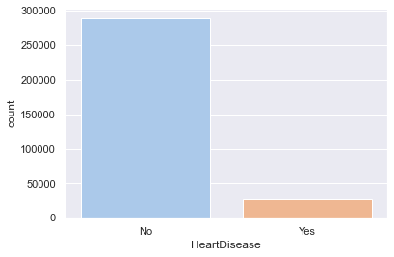
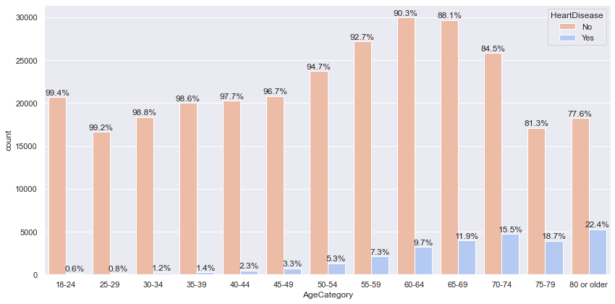
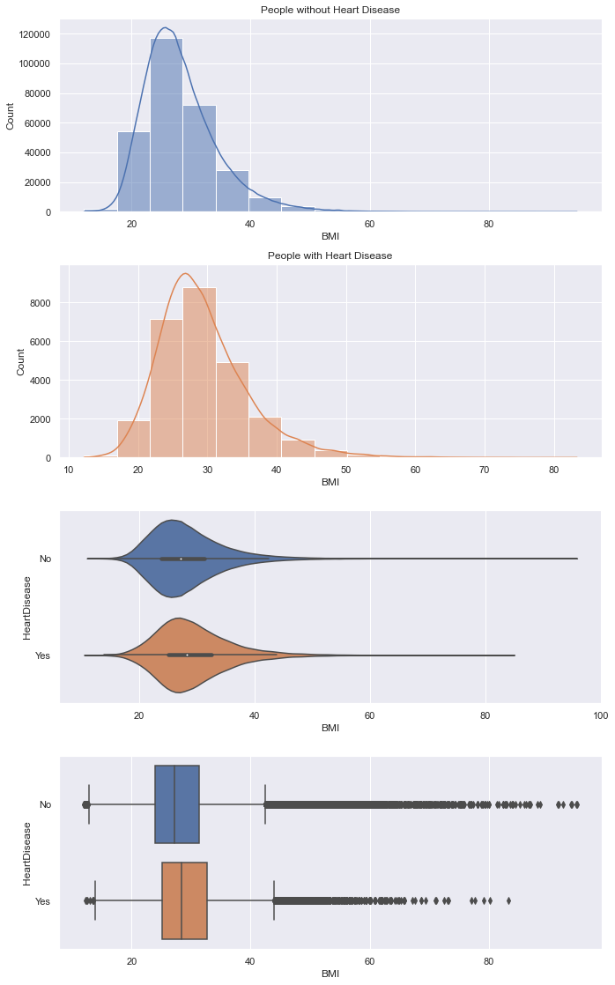
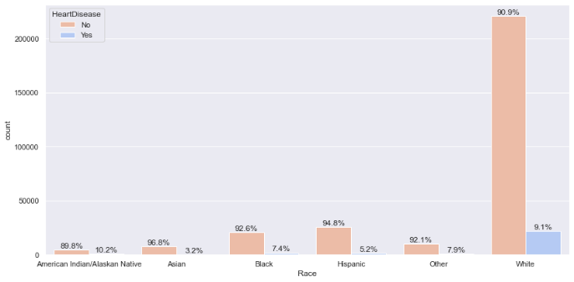
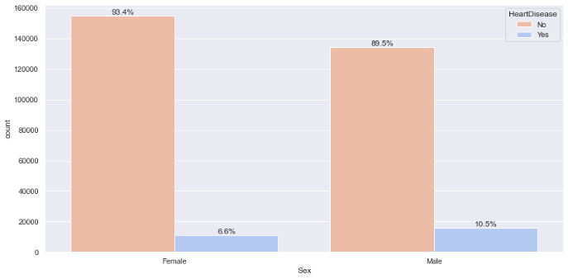
Stage 1: Individual Empowerment – Data Exploration
Jiang Lei
Distribution of Heart Disease
Demographical Variable(s)
Age VS Heart Disease
age increases, % of HD patients increases
> 10% HD patients among 65+ people
BMI VS Heart Disease
The distribution of BMI was very similar in cardiac patients and non-patients.
Unbalanced Predictor Variable
91% of rows – Low risk
9% of rows – High risk
Algorithm-based Sampling Required
Be Alert of Overfitting of Models
Race / Gender VS Heart Disease
The proportion of people with heart disease is very similar across gender and race.
Notes:
Stage 1: data exploration

Slide 8
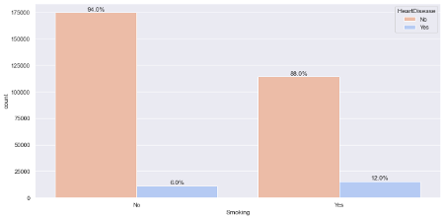
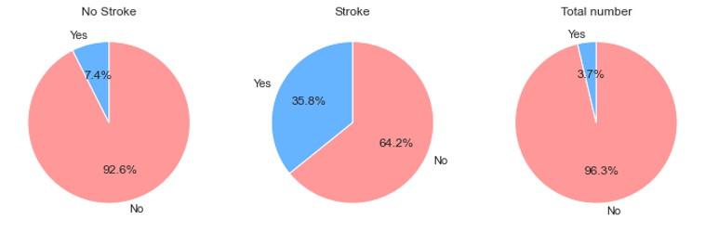
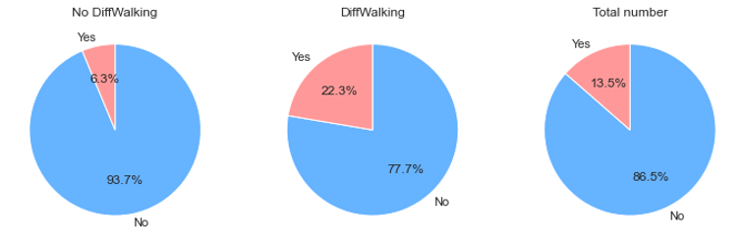

Stage 1: Individual Empowerment – Data Exploration
Jiang Lei
Lifestyle Variable(s)
Medical History Variable(s)
Current Health Variable(s)
Smoker VS Heart Disease
12% of smokers are heart patients,
2 times of the non-smokers.
Stroke VS Heart Disease
35.8% of stroke patients also have heart disease, 5 times of the non-stroke patients.
Difficulty in Walking
VS Heart Disease
22% of HD patients with difficulty in walking, 3.5 times of non-HD patients
Smoking damages blood vessels, reduces the amount of oxygen in the blood,
worsens heart conditions.
(Health Hub, 2022)
Similarly,
for people have been diagnosed with diabetes or kidney disease
People walk fast always
show better cardiac status.
(Yates, et al., 2017)
High blood sugar caused by diabetes can damage blood vessels in the heart.
(Singapore Heart Foundation, 2022)
Sources: HealthHub (2022), Singapore Heart Foundation (2022), Yates, et.al. (2017)
Notes:
Stage 1: data exploration

Slide 9



Stage 1: Individual Empowerment – Pre-Modelling
Jiang Lei
Train-Test Split
Oversampling by SMOTE
Performance Metric
The data set is randomly divided into training and test sets in a ratio of 7:3.
Sampling was required due to the disease-:non-disease imbalance distribution of 1:10.
Synthetic Minority Oversampling Technique (SMOTE) employed to oversample the trainset
Generates synthetic samples for “Heart Disease - Yes” group using other variables
Overcomes the overfitting problem
Classification Accuracy
Percentage of correct prediction
(>80%)
ROC AUC score
Evaluate the performance of single model at different thresholds
(>70%)
False Negative Rate
Error of misclassifying high-risk populations as low risk
(prediction 0, truth 1)
(<20%)
Notes:
Modelling: preparation + metrics + oversampling

Slide 10
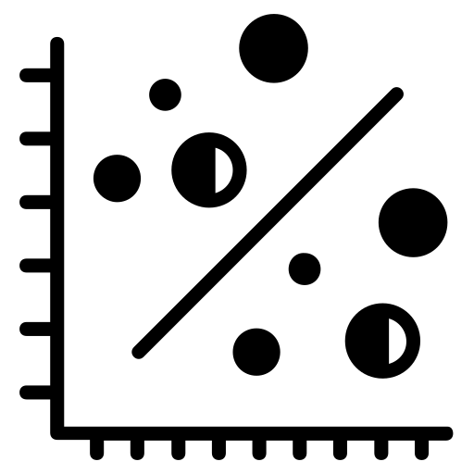

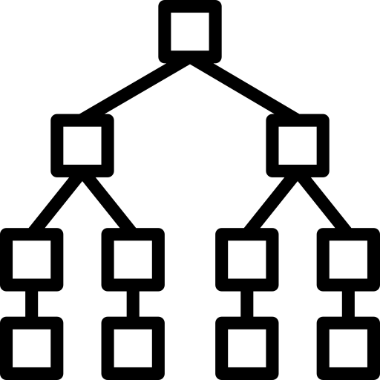
Stage 1: Individual Empowerment – Models
Jiang Lei
Logistic Regression
Model
Gradient Boosting Classifier
Random Forest
Model
Efficient machine learning classification algorithms
A more robust model
learns iteratively from each weak learner
an ensemble of decision trees
randomly selects variables and averages the prediction results
Model Optimization
3 Models Trained with
Recursive Feature Elimination
Cleaned dataset contains up to 50 one-hot-encoding variables
Model trained with
Hyperparameter Tuning
Conducted on 2 parameters
n_estimators, learning_rate
Mitigate overfitting issue
Highly stable
Training time longer due to complexity
Optimal Model uses
21 variables (7 features)
11 Important features
are highlighted
All 17 features are used
Finding the best model based on
3 predetermined metrics
Notes:
Modelling: 1. logistic regression
highly stable as the average answers given by a large number of trees are taken

Slide 11
Stage 1: Individual Empowerment – Model Evaluation & Selection
Jiang Lei
Logistic Regression
Gradient Boosting Classifier
Random Forest
Overall Accuracy | 74.22% |  | 87.54% |  | 99.62%
False Negative Rate | 78.46% |  | 72.28% |  | 1.70%
ROC-AUC Score | 0.75 |  | 0.63 |  | 0.99
Lowest Accuracy
Worst FNR & Fair Score
Poor FNR
High Accuracy & Lowest Score
Best FNR
Highest Accuracy & Score
BMI
Age
Sleep Time
Diabetic
Race
Difficulty in Walking
General Health Status
Gender
Physical Health
Mental Health
Smoking
Stroke
Physical Activity
Skin Cancer
Asthma
Kidney Disease
Alcohol Drinking
Important Features used in Random Forest
How to build trust among end users (individuals) when interpreting predicted results (high risk/low risk)?
Notes:
Modelling: 1. logistic regression
Physical Health
Mental Health
Smoking
Stroke
Physical Activity
Skin Cancer
Asthma
Kidney Disease
Alcohol Drinking

Slide 12
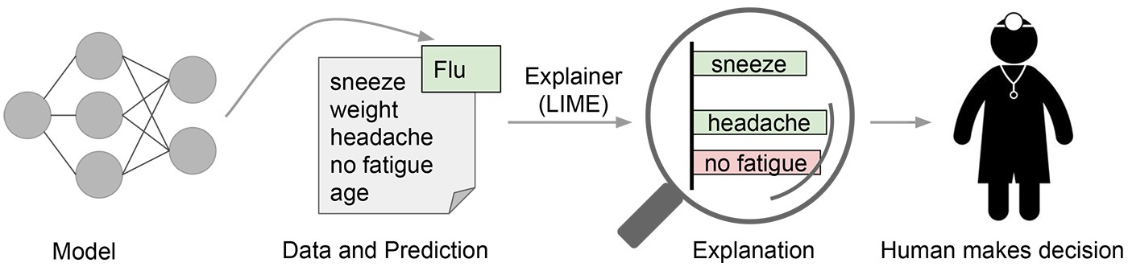
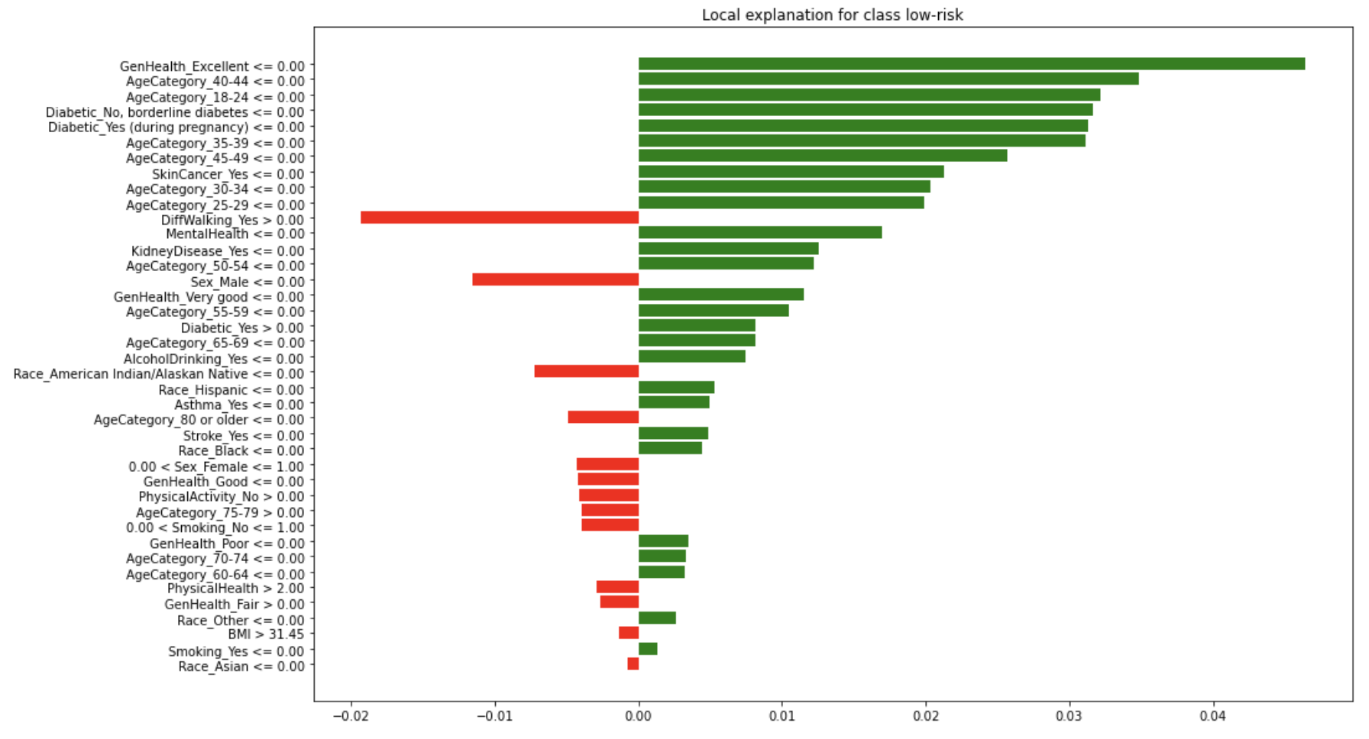

Stage 1: Individual Empowerment – Model Explainer
Jiang Lei
Sample Analytic Report for An Individual
Local Interpretable Model-Agnostic
(LIME)
Congratulations! You are at low-risk for heart disease.
However, please take note of the following factors (in red) that negatively contribute to your heart health.
Trust in Model Using Accuracy Metrics
Test-set to measure model performance,
but still different from real-world data
Trust in Personal Predictions
Use positive & negative drivers (variables)
to explain prediction results and gain user trust
Ensure Local fidelity
Globally important features may not be significant
in the local context
Only a handful of variables directly relate to
an individual prediction
Notes:
To figure out which parts of the interpretable inputs contribute to the predictions, we perturb the inputs around their neighborhoods and see how the model's predictions behave. We then weight these perturbed data points by their proximity to the original example, and learn an interpretable model on these and related predictions.
the explanation for individual predictions should at least be locally faithful, i.e. it must correspond to how the model behaves in the vicinity of the individual observation being predicted. The authors address that local fidelity does not imply global fidelity: globally important features may not be important in the local context, and vice versa. Because of this, it could be the case that only a handful of variables directly relate to a local (individual) prediction, even if a model has hundreds of variables globally.

Slide 13
Stage 2: Primary Care Prediction – Overview
Jing Qiang
1
2
3
4
5
Data Collection
From Kaggle
[303 rows & 14 columns]
Data Preprocessing
Data Cleaning
Label Encoding & Encoding to Meaningful Strings
Data Exploration
Feature Insights
Model Training
Optimize each model
&
Select best model
with predefined metrics
Model Explainer
Understand black-box algorithm
Interpret Prediction
Notes:
Stage 2 Prediction at primary care: [listing data, overview of dataset]

Slide 14




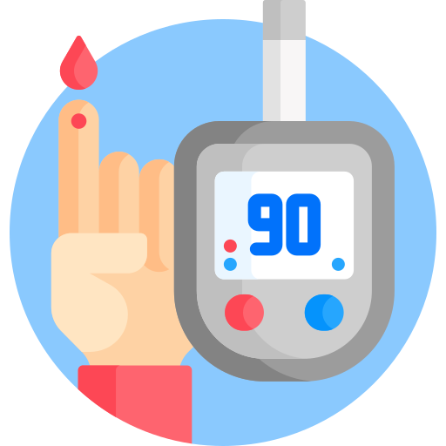
Stage 2: Primary Care Prediction – Data Overview
Jing Qiang
Patients
Personal + Medical
Information
Doctor's Evaluation on Heart Health
Personal
Variables
Electrocardiogram Variables
Blood-related
Variables
Other Medical
Variables
Age
Sex
Chest Pain
* Are you experiencing chest pain?
Heart Rate
O2 Saturation
Rest ECG
* Resting ECG Results (0-2)
Resting Blood Pressure
Fasting Blood Sugar
Cholesterol
Exercise Induced Angina
Number of major vessels
* NOT blocked or interrupted by a build-up of fatty substances

Slide 15
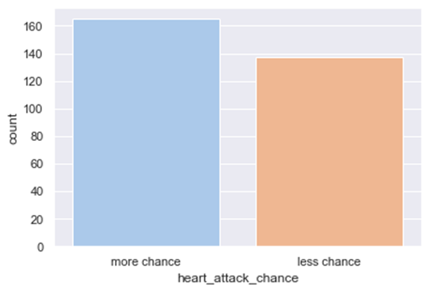
Stage 2: Primary Care Prediction – Data Exploration
Jing Qiang
Distribution of Heart Attack
Balanced Predictor Variable

Slide 16
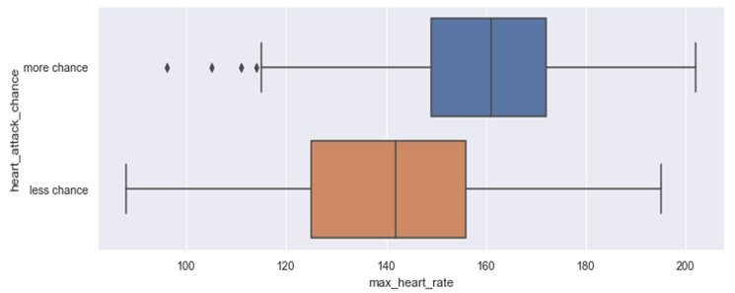
Stage 2: Primary Care Prediction – Data Exploration
Jing Qiang
Variable(s) - In-Line With Academic Research
Max Heart Rate VS Heart Attack
The chances of heart disease increases when one has a
higher max heart rate (~160bpm vs ~140bpm)
(Perret-Guillaume, Joly, & Benetos, 2009)
Sources: Perret-Guillaume, Joly, & Benetos (2009)

Slide 17
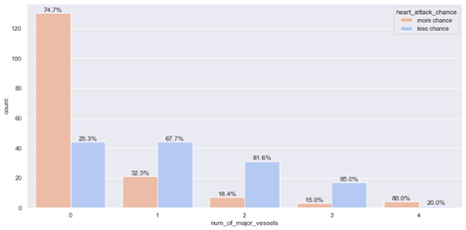
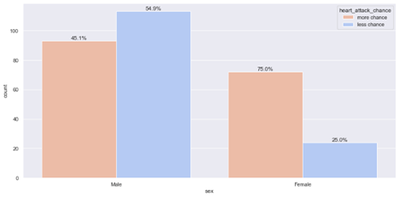
Stage 2: Primary Care Prediction – Data Exploration
Jing Qiang
Variable(s) - In-Line With Academic Research
Number of major vessel VS Heart Attack
The more blood vessels detected (not blocked or interrupted by fatty substances) by fluoroscopy, the lower the chance of having a high risk of heart disease.
Gender VS Heart Attack
Females are shown to be at a higher risk of a heart attack
(females' 75% vs males' 45.1%)
(Carauna, 2018 )
Sources: Carauana (2018)

Slide 18
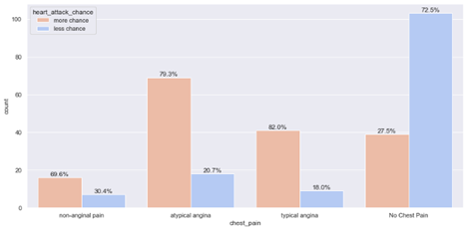
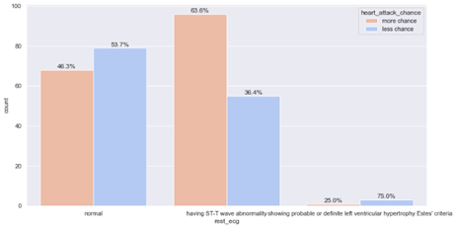
Stage 2: Primary Care Prediction – Data Exploration
Jing Qiang
Variable(s) - In-Line With Academic Research
Chest Pain VS Heart Attack
Those with chest pain has a greater than 69.6% of having a higher chance of heart attack
(Singapore General Hospital, n.d.)
Rest ECG VS Heart Attack
Those with ST-T wave abnormality has 17.3% more chance of higher risk of heart attack
(Beckerman, et al., 2005)
Sources: Singapore General Hospital (n.d.), Beckerman, et al. (2005)

Slide 19
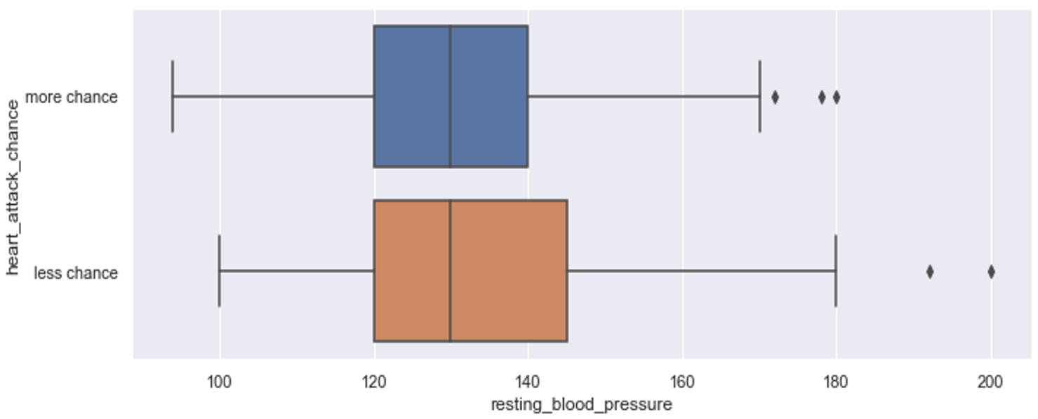
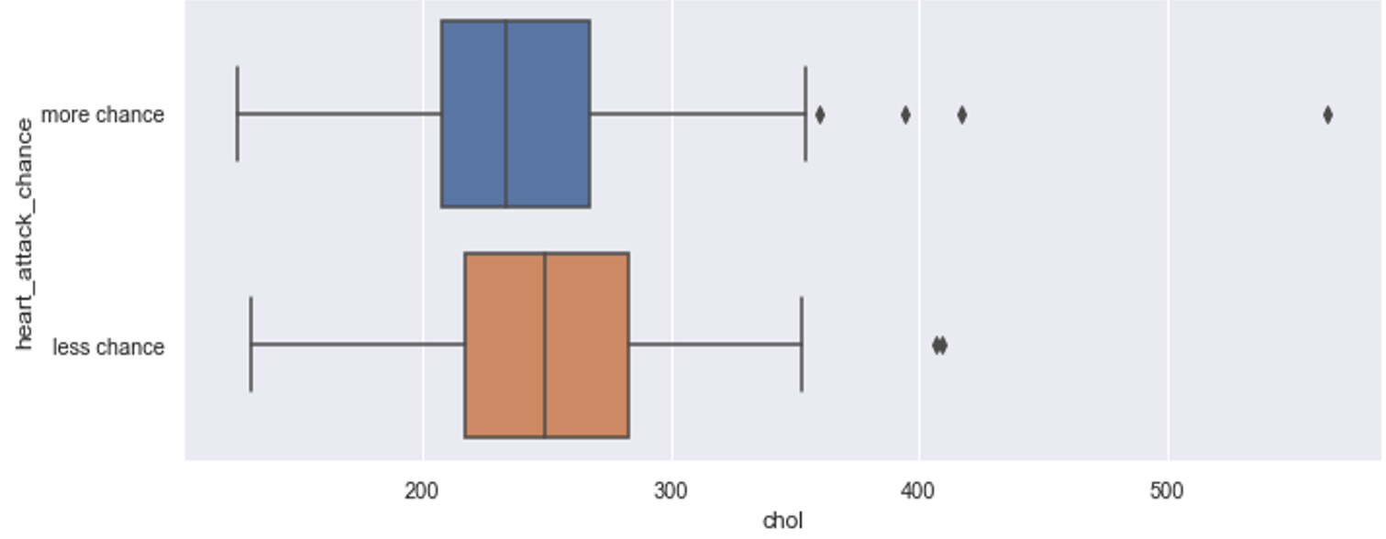
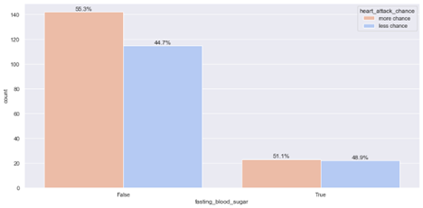
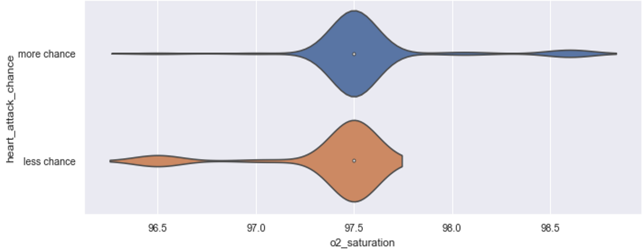
Stage 2: Primary Care Prediction – Data Exploration
Jing Qiang
Variable(s) - No Significant Impact
Heart Attack Chance VS Heart Attack
Cholesterol VS Heart Attack
Fasting Blood Sugar VS Heart Attack
O2 Saturation VS Heart Attack

Slide 20
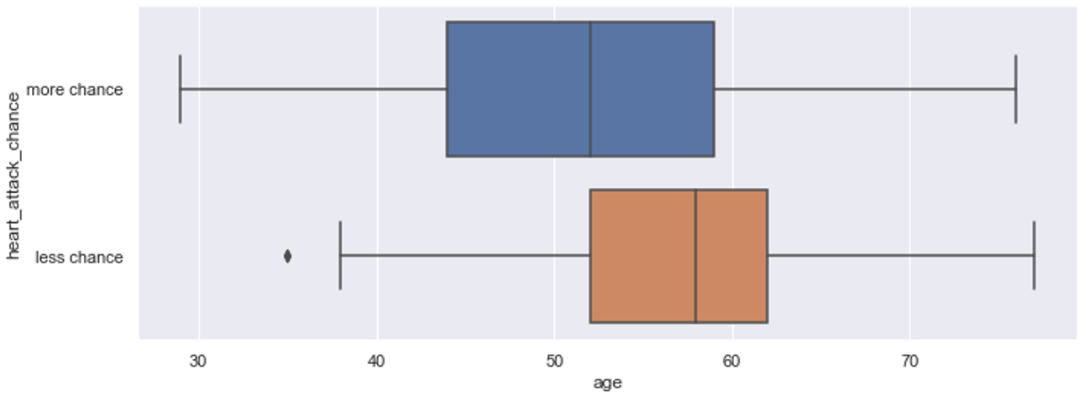
Stage 2: Primary Care Prediction – Data Exploration
Jing Qiang
Variable(s) - Contradicts Current Research
Age VS Heart Attack
The younger you are, the higher the risk of you getting a heart disease, which contradicts existing research (Rodgers, et al., 2019)
Source: Rodgers, et al. (2019)

Slide 21
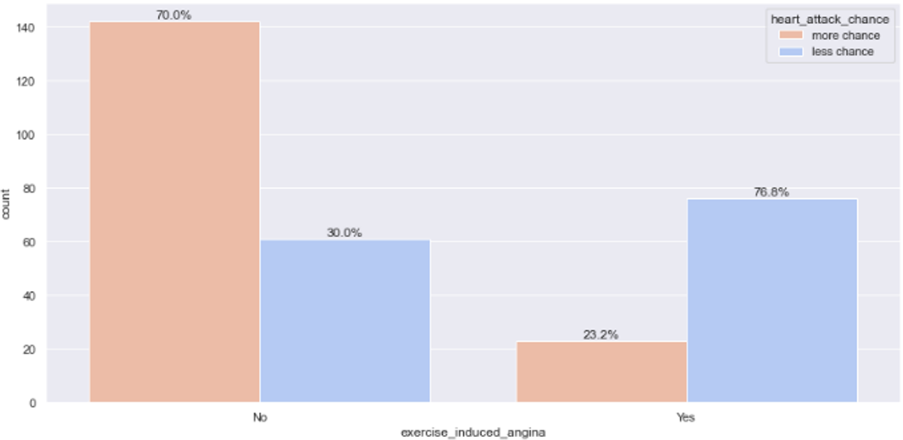
Stage 2: Primary Care Prediction – Data Exploration
Jing Qiang
Variable(s) - Contradicts Current Research
Exercised Induced Angina VS Heart Attack
Having exercise-induced angina is a common complaint of cardiac patients (Brown & Oldridge, 1985), but our exploration shows not having exercise-induced angina means one have is at a higher risk of heart disease.
Source: Brown & Oldridge. (1985)

Slide 22
Stage 2: Primary Care Prediction – Pre-Modelling
Jing Qiang
Train-Test Split
Cross Validation (5-fold)
Performance Metric
The data set is randomly divided into training and test sets in a ratio of 7:3.
Cross Validation was required due to the small size of the dataset.
5-fold Cross Validation is employed to evaluate analytical models on the limited train dataset sample.
It splits the train dataset into 5 groups, using 4 groups to train the model and 1 group to validate the model. This is repeated for all possible combinations of the 5 groups.
Overcomes the limited dataset problem.
Classification Accuracy
Percentage of correct prediction
(>80%)
ROC AUC score
Evaluate the performance of single model at different thresholds
(>70%)
False Negative Rate
Error of misclassifying high-risk populations as low risk
(prediction 0, truth 1)
(<=20%)

Slide 23

Stage 2: Primary Care Prediction – Models
Jing Qiang
Classification & Regression Tree (CART) Model
Random Forest Model
Model Optimization
Efficient machine learning classification algorithms
An ensemble of many CART that
randomly selects variables and averages the prediction results
Growing Tree to the Maximum
using default hyperparameters
Feature Importance
Dropping features with importance value of 0
Prune tree using cp value chosen from tree with the minimum cross validation error
Hyperparameter Tuning using GridSearchCV
Finding the best model based on
3 predetermined metrics

Slide 24


Stage 2: Primary Care Prediction – Model Evaluation & Selection
Jing Qiang
Logistic Regression
Random Forest
Overall Accuracy | 74.41% |  | 85.06%
False Negative Rate | 30.43% |  | 20.93%
ROC-AUC Score | 0.78 |  | 0.84
Poor Accuracy
Undesirable FNR & ROC-AUC Score
Best FNR
Highest Accuracy & ROC AUC Score
Max Heart Rate
Number of major vessels
Chest Pain
Age
Exercise Induced Angina
Cholesterol
Resting Blood Pressure
Sex
O2 Saturation
Rest ECG
Fasting Blood Sugar
Important Features
used in
Random Forest
How can end-user (doctors) interpret prediction result – high risk / low risk, and proceed from this result?

Slide 25
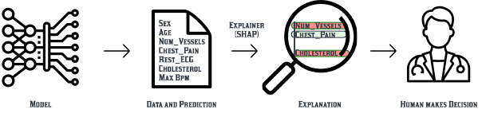
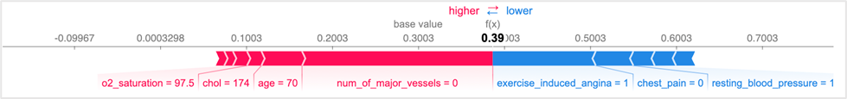
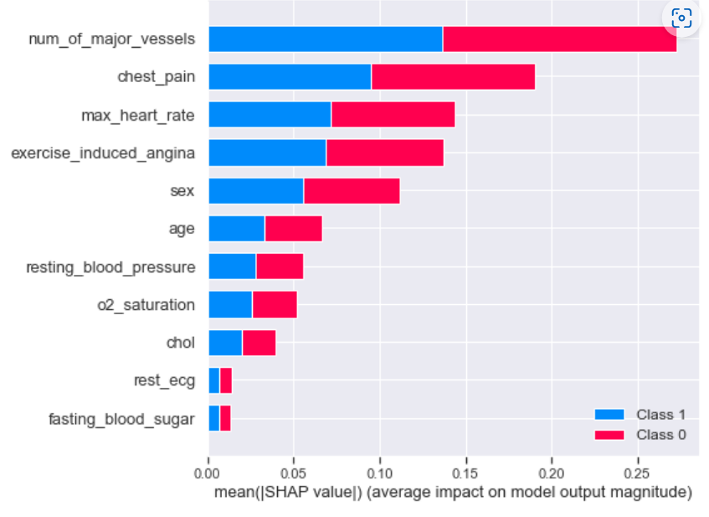
Stage 2: Primary Care Prediction – Model Explainer
Jing Qiang
Sample Analytic Report about a Patient for A Doctor
SHapley Additive exPlanations
(SHAP)
Danger! The patient is at high-risk for heart disease.
The following factors (in blue) contribute to the patient's high risk heart health. Conduct a more detailed medical test / administer treatments in those areas.
Enables Global Interpretability
The collective SHAP values can show how much each predictor contributes, either positively or negatively, to the target variable.
Enables Local Interpretability
Each prediction has its own set of SHAP values, increasing transparency as it enables doctors to pinpoint and contrast the impacts of different features on the prediction
Trust in Heart Predictions
Use positive & negative drivers (variables)
to explain prediction results and gain
doctors and patients' trust

Slide 26
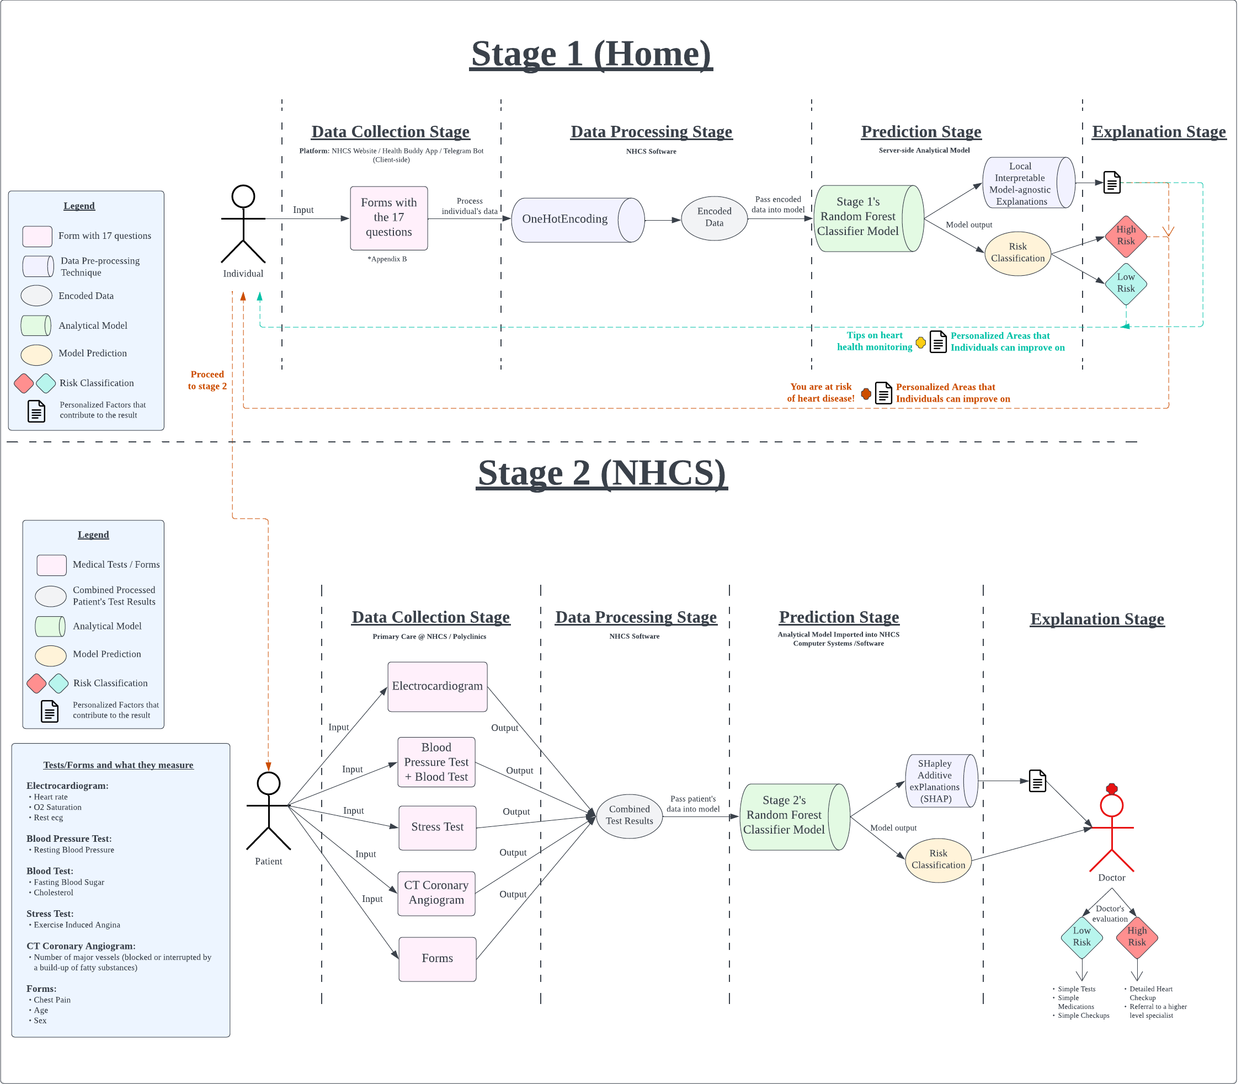
Business
Implementation
Zainab

Slide 27
Business Implementation: Stage 1 – Technical Flowchart
Zainab

Slide 28









Business Implementation: Stage 1 – End Users
Zainab
Potential
End
Users
General Public
Who is aware of monitoring his/her heart health
Visitors of NHCS
Found to have symptoms of heart attack
Patients with Relevant Medical History
Diabetes, Stroke, etc.
Jolin, 23
NTU Student
Amy, 40
Have chest pain
Jay, 65
Stroke Patient
Accessible Methods
Proactively use prediction tool through online platforms e.g., SingHealth Website,
HealthBuddy App,
Telegram Bot
An invitation link to online risk prediction will be sent to their phones periodically as a reminder for regular heart health monitoring
Work with Active Ageing Hub / Eldercare Centre
to provide manual data collection and automated risk prediction
for seniors who have difficulty accessing the Internet

Slide 29
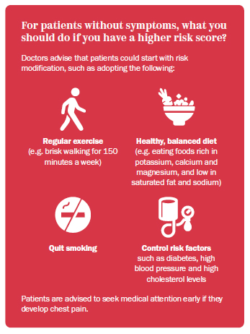
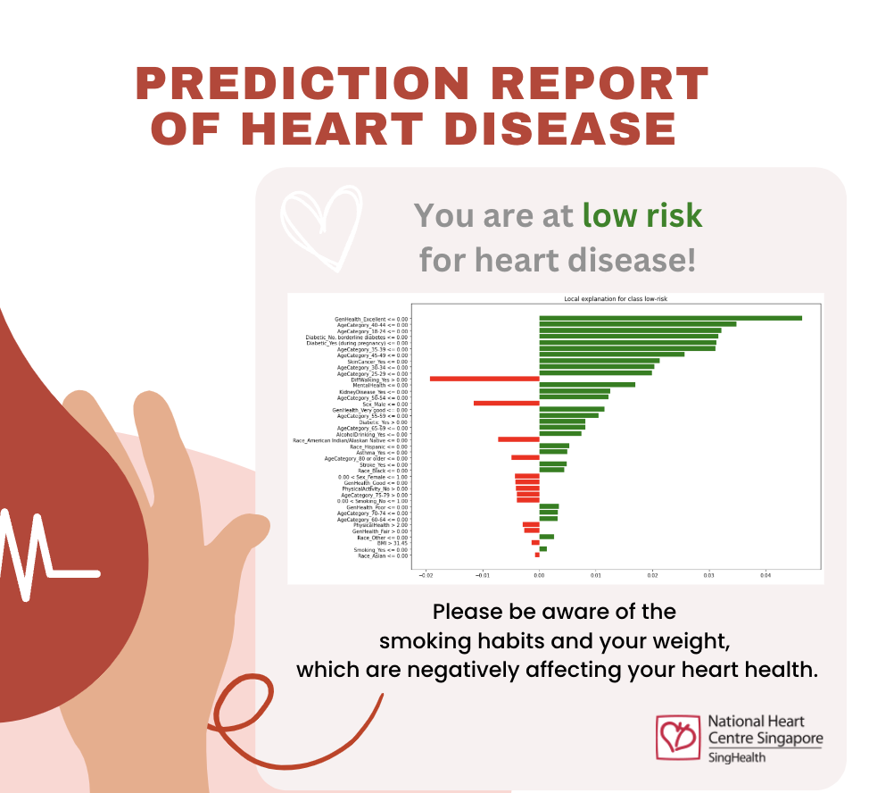

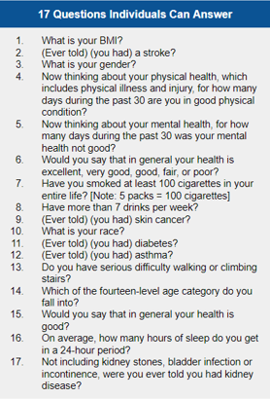
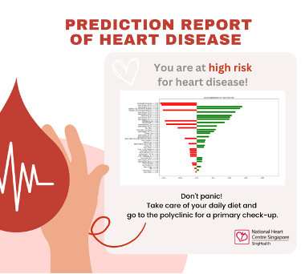

Business Implementation: Stage 1 – User Journey Map
Zainab
Low Risk
instructed to maintain heart health
Answer Simple Questionnaire
17 non-medical indicators
will be used as inputs for the questionnaire
Jay, 65
Stroke Patient
2
Receive Risk Prediction Result & Analytics Report
3
Decision Making
High Risk
guide users to primary care @ NHCS for primary heart checkup
Stage 2
Prediction of Heart Disease Risk using medical attributes

Slide 30
Business Implementation: Stage 2 – Technical Flowchart
Zainab

Slide 31


Zainab
Business Implementation: Stage 2 – Implementation Scenario
Who?
High Risk Individuals
identified in stage 1
Regular individuals
with appointment for heart related issues
Where?
Primary Care Facilities
such as NHCS and Polyclinics
How?
Analytical model pre-trained and saved to the system
Can be exported for import in other systems and hospitals

Slide 32



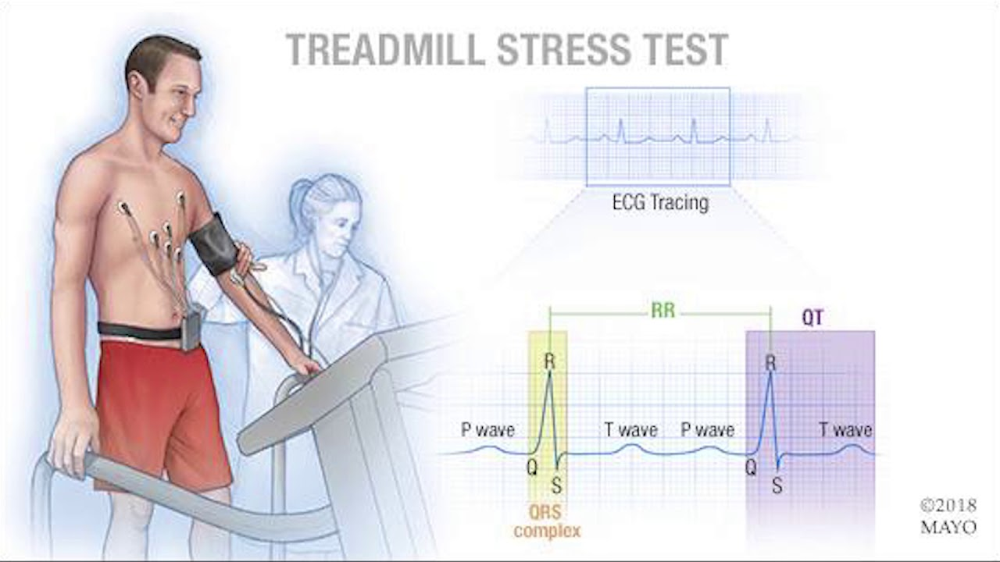
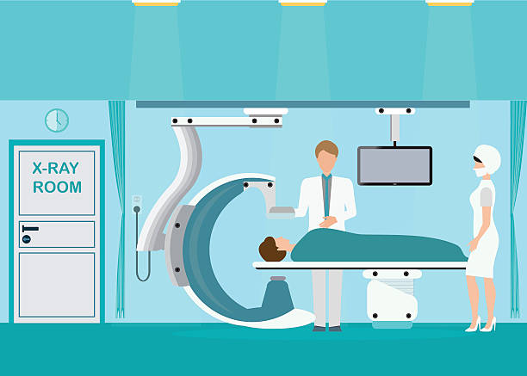
Business Implementation: Stage 2 – User Journey Map
Zainab
2
3
Primary Tests
5 basic tests conducted at primary care
Received Risk Prediction Result
With analytics report
Decision Making
Based on Risk Prediction Level & Analytics Report & Expertise
Amy, 40
Self-checked High-risk Patient
ECG
Given simple testing with medications and screening
Advised to use
stage 1 self-prediction tool to monitor heart health closely
Blood Test
Low Risk
Analyze reports to understand the patient's heart health and make recommendations accordingly
Blood Pressure
Determine the next course of action according to significant contributing factor
e.g., detailed cardiac examinations and referrals to heart center / specialist consultant
High Risk
Report reveals which factors contribute significantly to the patient's high risk, such as chest pain, and takes the next relevant detailed tests (e.g., screening for coronary artery disease).
Stress Test
CT Coronary Angiography

Slide 33




Expected Outcomes
Bryan
Raise Public Awareness
Provide Timely Alert
Optimise Medical Procedures
By answering the questions required for stage 1, individuals gain awareness of the risk factors for heart disease
From the prediction result, individuals can seek timely intervention before the heart disease materialises.
Individuals would know if they need go for a heart check-up
Doctors would be able to optimise the next course of action for patient
Notes:
Expected outcome

Slide 34

Comparison with Latest Solution
Bryan
Stage 1
Stage 2
Allow people to self-detect their risk of having heart disease
Allow doctors to detect the risk of having heart disease
Allow patients/doctors to self-detect/detect the risk of having coronary artery disease
Purpose
Variables
17
11
7
Model Used
Random Forest
Random Forest
Logistic Regression
Explainer Model
LIME
SHAP
-
Output
High Risk (1) or Low Risk (0)
(Categorical) with Explanation of factors
High Risk (1) or Low Risk (0)
(Categorical) with Explanation of factors
Probability of having CAD (Continuous)
Notes:
Expected outcome

Slide 35



Comparison Analysis: By offering a more personalised approach with clearer explanations for our model, we are better than PRECISE
Bryan
Purpose
Variables
vs
PRECISE
vs
PRECISE
Detect heart diseases for everyone
Detect CAD for people with chest pain above 30 years
Different Variables for each stage to offer a more personalised output
Same Variables whether for clinical usage or nonclinical usage
Output
PRECISE
Gives users a categorical output of whether they are high or low risk
Provide a percentage to users to interpret whether they are high or low risk
vs
Explains to them why they obtained the given result
No explanation of how the percentage is derived
Notes:
Expected outcome

Slide 36



Limitations, and our strategies to get mitigate them
Gerald
Dataset Limitations
Data Origin
Dataset used is based on American individual data, which may lose accuracy in local implementation
Notes:
Limitations and future improvements

Slide 37

Limitations, and our strategies to get mitigate them
Gerald
Dataset Limitations
Data Origin
Dataset used is based on American individual data, which may lose accuracy in local implementation
Data Imbalance
Dataset used is imbalanced in terms of individuals with low and high risk of heart disease
Notes:
Limitations and future improvements

Slide 38
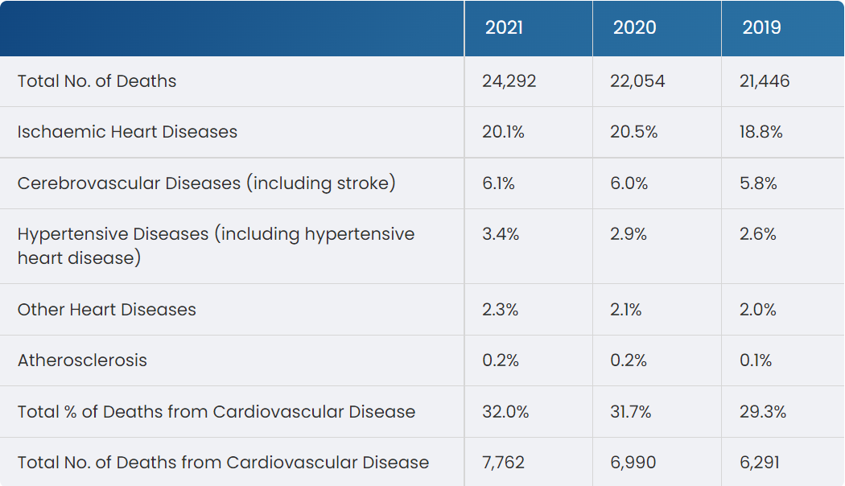
Limitations, and our strategies to get mitigate them
Gerald
Dataset Limitations
Data Origin
Dataset used is based on American individual data, which may lose accuracy in local implementation
Data Imbalance
Dataset used is imbalanced in terms of individuals with low and high risk of heart disease
Notes:
Limitations and future improvements

Slide 39




Limitations, and our strategies to get mitigate them
Gerald
Dataset Limitations
High Blood Pressure
Data Origin
Dataset used is based on American individual data, which may lose accuracy in local implementation
Data Imbalance
Dataset used is imbalanced in terms of individuals with low and high risk of heart disease
High Cholesterol
Other factors
Other risk factors such as genetics, were not considered though research has shown its role in risk prediction
History of Heart Disease
Notes:
Limitations and future improvements

Slide 40
Limitations, and our strategies to get mitigate them
Gerald
Dataset Limitations
Mitigating Strategies
Data Origin
Dataset used is based on American individual data, which may lose accuracy in local implementation
Collecting more cardiovascular disease data from Singaporeans
Data Imbalance
Dataset used is imbalanced in terms of individuals with low and high risk of heart disease
Research or consult experts to determine which genetic indicators are valuable
Other factors
Other risk factors such as genetics, were not considered though research has shown its role in risk prediction
Notes:
Limitations and future improvements

Slide 41





Conclusion
Gerald
Stages
Increase involvement of individuals and primary care sector
Stage 1
Individual Empowerment
Convenient self-predicting & monitoring tool
Reduce life-threatening impacts of Heart Disease through early detection, timely intervention and optimal treatment
Stage 2
Prediction @ Primary Care
A decision support tool for physicians to make decisions based on analytics result
Shift the focus from post-diagnosis treatment to prevention

Slide 42

Conclusion
THANKS!
If you have any question, feel free to contact us at:
Email: Jlei002@e.ntu.edu.sg
GitHub: https://github.com/xJQx/bc2406-project

Slide 43
References
Carauna, C. (2018 , December 14). SciDev.Net. Retrieved from Lifestyle diseases swamp Asia’s healthcare systems : https://www.scidev.net/asia-pacific/news/lifestyle-diseases-swamp-asia-s-healthcare-systems/
Perret-Guillaume, C., Joly, L., & Benetos, A. (2009). Heart rate as a risk factor for cardiovascular disease . Prog Cardiovasc Dis. , 6-10.
Heart failure - alcohol and smoking. HealthHub. (n.d.). Retrieved October 29, 2022, from https://www.healthhub.sg/a-z/diseases-and-conditions/716/Heart-Failure-Alcohol-and- Smoking#:~:text=Smoking%20damages%20the%20blood%20vessels,lung%20diseases%20and%20sto mach%20ulcers.
Piepoli, M. F., Hoes, A. W., Agewall, S., Albus, C., Brotons, C., Catapano, A. L., . . . Løchen, M.-L. (2016). 2016 E uropean Guidelines on cardiovascular disease prevention in clinical practice . EAS Updates, 207-274.
Qian, X., Li, Y., Zhang, X., Guo, H., He, J., & Wang, X. (2022). A Cardiovascular Disease Prediction Model Based on Routine Physical Examination Indicators Using Machine Learning Methods: A Cohort Study . Front. Cardiovasc. Med. .
Singapore Heart Foundation. (2022). Singapore Heart Foundation. Retrieved from Heart Disease Statistics: https://www.myheart.org.sg/health/heart-disease-statistics/
Yates, T., Zaccardi, F., Dhalwani, N. N., Davies, M. J., Bakrania, K., Celis-Morales, C. A., . . . Khunti, K. (2017). Association of walking pace and handgrip strength with all-cause, cardiovascular, and cancer mortality: a UK Biobank observational study . European Heart Journal, 3232-3240.

